Slide 1
Computer Organization and Assembly Language

Slide 2
shift
There are two kinds of shift: logical and arithmetic.
The logical shift is for unsigned operands, and the arithmetic shift is for signed operands.
The number of times (or bits) that the operand is shifted can be specified directly if it is once only, or through the CL register if it is more than once.

Slide 3
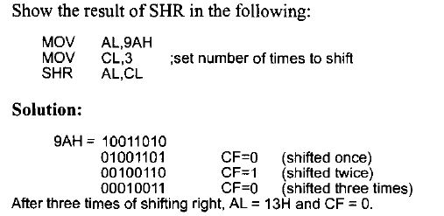

SHR
This is the logical shift right.
The operand is shifted right bit by bit, and for every shift, the LSB (least significant bit) will go to the carry flag (CF), and the MSB (most significant bit) is filled with 0.
Examples should help to clarify SHR.

Slide 4
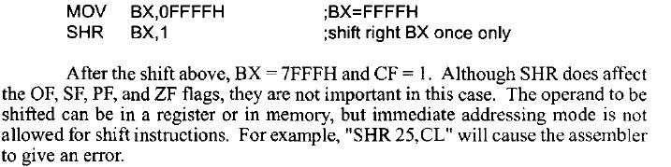
SHR
If the operand is to be shifted once only, this is specified in the SHR instruction itself rather than placing I in the CL. This saves coding of one instruction:

Slide 5
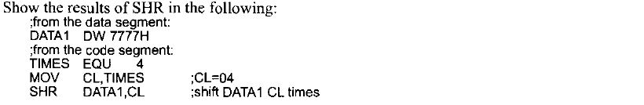
SHR

Slide 6

SHL
Shift left is also a logical shift.
It is the reverse of SHR. After every shift, the LSB is filled with 0, and the MSB goes to CF.
All the rules are the same as SHR.

Slide 7

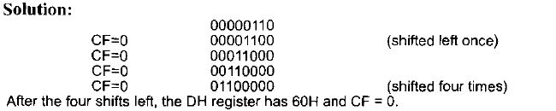
SHL

Slide 8
ARITHMETIC SHIFT
The arithmetic shift is used for signed numbers.
It is basically the same as the logical shift, except that the sign bit is copied to the shifted bits.
SAR (shift arithmetic right) and SAL (shift arithmetic left) are two instructions for the arithmetic shift.

Slide 9

SAR
SAR destination, count
As the bits of the destination are shifted to the right into CF, the empty bits are filled with the sign bit.
One can use the SAR instruction to divide a signed number by 2.

Slide 10

Example

Slide 11
SAL
These two instructions, SAL and SHL, do the same thing.
It is basically the same instruction with two mnemonics.
As far as signed numbers are concerned, there is no need for SAL.

Slide 12
Rotate instruction
In many applications, there is a need to perform a bitwise rotation of an operand.
The rotation instructions ROR, ROL, and RCR, RCL are designed specifically for that purpose.
They allow a program to rotate an operand right or left.
In rotate instructions, the operand can be in a register or memory. If the number of times an operand is to be rotated is more than 1, this is indicated by CL.
This is similar to the shift instructions.
There are two types of rotations.
One is a simple rotation of the bits of the operand, and the other is a rotation through the carry.

Slide 13

ROR - rotate right
In rotate right, as bits are shifted from left to right, they exit from the right end (LSB) and enter the left end (MSB).
In addition, as each bit exits the LSB, a copy of it is given to the carry flag.
In other words, in ROR, the LSB is moved to the MSB and is also copied to CF, as shown in the diagram.
If the operand is to be rotated once, the I is coded, but if it is to be rotated more than once, register CL is used to hold the number of times it is to be rotated.

Slide 14
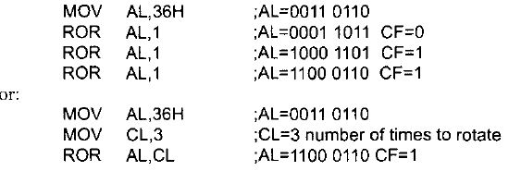
ROR - rotate right

Slide 15

Task to do!

Slide 16

ROL - rotate left
In rotate left, as bits are shifted from right to left, they exit the left end (MSB) and enter the right end (LSB).
In addition, every bit that leaves the MSB is copied to the carry flag.
In other words, in ROL, the MSB is moved to the LSB and is also copied to CF, as shown in the diagram. If the operand is to be rotated once, the I is coded.
Otherwise, the number of times it is to be rotated is in CL.

Slide 17
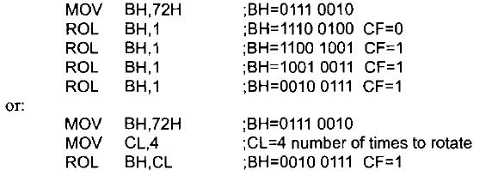
ROL - rotate left

Slide 18

Task to do!

Slide 19
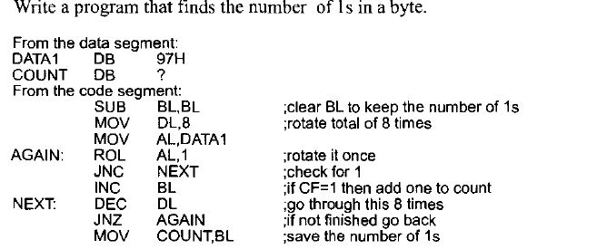
Example

Slide 20
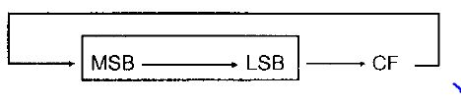
RCR - rotate right through carry
In RCR, as bits are shifted from left to right, they exit the right end (LSB) to the carry flag, and the carry flag enters the left end (MSB).
In other words, in RCR, the LSB is moved to CF, and CF is moved to the MSB.
In reality, CF acts as if it is part of the operand.
If the operand is to be rotated once, the I is coded, but if it is to be rotated more than once, the register CL holds the number of times.

Slide 21
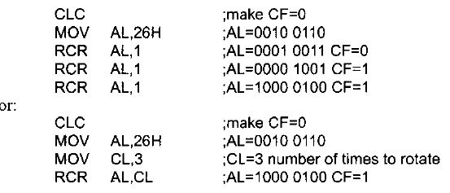
Example

Slide 22
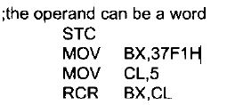
TASK to do!

Slide 23
RCL - rotate left through carry
In RCL, as bits are shifted from right to left, they exit the left end (MSB) and enter the carry flag, and the carry flag enters the right end (LSB).
In other words, in RCL, the MSB is moved to CF, and CF is moved to the LSB.
In reality, CF acts as if it is part of the operand.
If the operand is to be rotated once, the I is coded, but if it is to be rotated more than once, register CL holds the number of times.

Slide 24

RCL - rotate left through carry
If the operand is to be rotated once, the I is coded, but if it is to be rotated more than once, register CL holds the number of times.

Slide 25
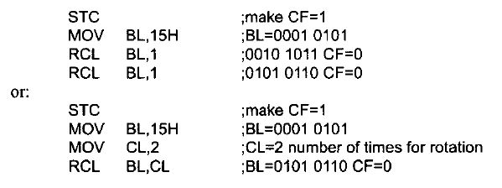
Example

Slide 26
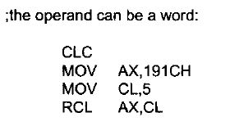
TASK to do!

